Slide 1
SOFTWARE TESTING
CH02: Testing Throughout SDLC
Course Instructor: AMIR IMAM

Slide 2

Contents
  Software Development Model with respect to testing
    Waterfall
    V-Model (Validation Verification)
    Agile (SCRUM/KANBAN)
  Testing Levels (Unit/Integration/System/UAT)
  Testing Types
    Functional (Sub types)
    Non Functional (Sub types)
    Others
  Bug Life cycle

Slide 3
Test Levels, Type and Approaches
Acceptance
Black Box
Conformance
Security
Grey Box
Internationalization
Performance
Load
Usability
System
GUI
Beta
Stress
Functional
White Box
Ad-hoc
Compatibility
Sanity
Exploratory
Integration
Unit
Capacity
Recovery
Smoke
Error-Handling
Regression
Alpha
Install/uninstall
Localization
Negative
Confirmation

Slide 4
Test Levels, Type and Approaches
  Unit Test
  Integration Test
  System Test
  User Acceptance (UAT)
  Functional Testing
  Non-Functional Testing
  Smoke Testing
  Regression Testing
  Re-Testing
  Performance Testing
  White-BOX Testing
  Positive Testing
  Automated Testing
  Manual Testing
  Security Testing
  Sanity Testing
  Alpha Testing
  Beta Testing
  Factor Acceptance Test (FAT)
  Site Acceptance Test (SAT)
  Usability Testing
  Stress Testing
  Load Testing
  Compatibility Testing
  Black-BOX Testing
  Negative Testing
  Static Testing
  Dynamic Testing

Slide 5
Testing Vs Debugging
Testing and debugging are different.
Executing Tests can show failures that are caused by defects in the software.
Debugging is the development activity that finds, analyzes, and fixes such defects.
Tester are responsible for the initial test and final confirmation Test.
Developers do the debugging and associated component testing.
However, in Agile development and in some other lifecycles, testers may be involved in debugging and component testing.

Slide 6
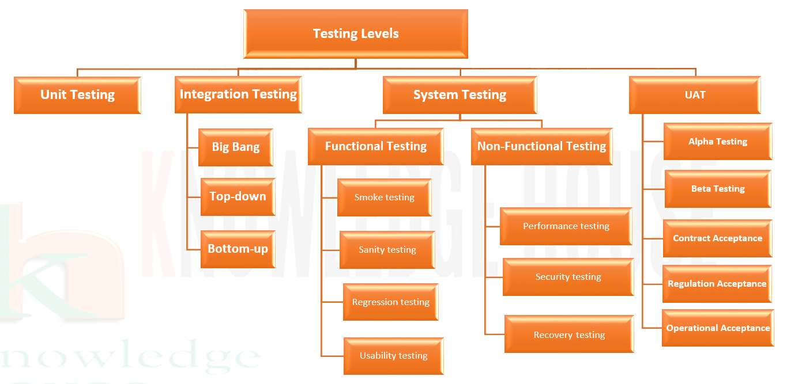
Test Levels, Type and Approaches
Notes:
`

Slide 7

Test Approaches
Proactive and Reactive
Manual and Automated
Black-box, White-box and Grey-box
Scripted and Unscripted
Static and Dynamic
7

Slide 8
Testing Levels
The test levels are:
Component testing
Integration testing
System testing
Acceptance testing

Slide 9
Testing Types
Testing of function
(Functional testing)
Testing based on an analysis of the specification of the functionality of a component or system.
Testing of software product characteristics
(Non-functional testing)
Testing based on quality attributes or characteristics of component or software.
Testing of software structure/architecture
(Structural testing)
Testing based on internal structure of component or system.
Testing related to changes (Confirmation and Regression testing)
Testing initiated based on changes in the system triggers by new functionality or bug.

Slide 10
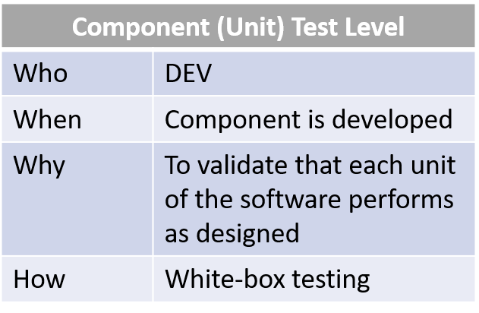

Test Levels, Type and Approaches
Acceptance
System
Integration
Test Basis
Test Basis
Component (Unit)
Testing on the Component (Unit) Test Level is called Component (Unit) testing

Slide 11
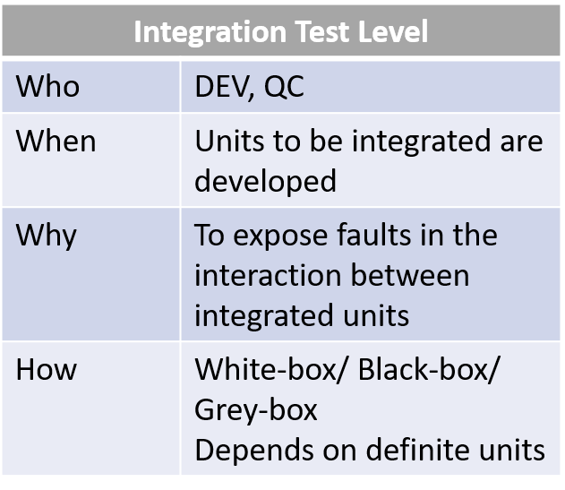

Test Levels, Type and Approaches
Acceptance
System
Integration
Component (Unit)
Testing on the Integration Test Level is called Integration testing

Slide 12
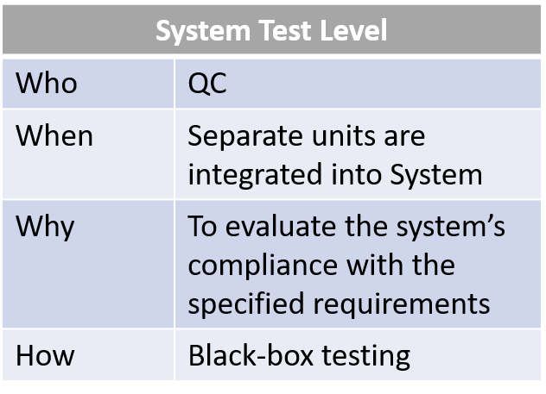

Test Levels, Type and Approaches
Acceptance
System
Integration
Component (Unit)
Testing on system level or System as a whole is called System testing

Slide 13
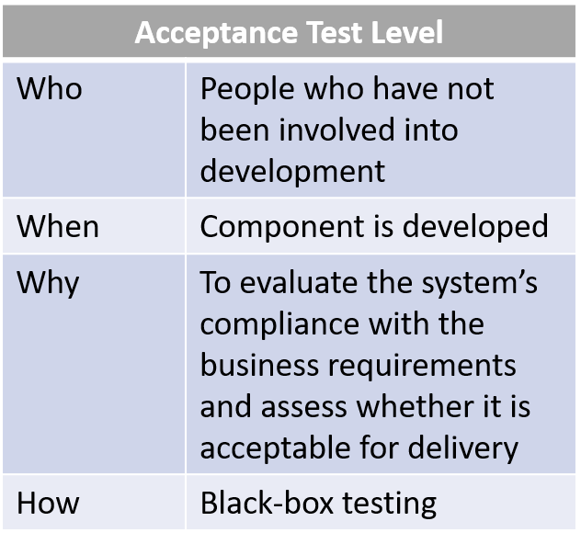

Test Levels, Type and Approaches
Acceptance
System
Integration
Component (Unit)
Testing on the Acceptance Test Level is called Acceptance testing

Slide 14
Test Levels, Type and Approaches
Component Testing
Objective | Reducing risk Verifying whether the functional and non-functional behaviors of the component are as designed and specified Building confidence in the component’s quality Finding defects in the component Preventing defects from escaping to higher test levels
Test Basis | Detailed design Code Data model Component specifications
Test Objects | Components, units or modules Code and data structures Classes Database modules
Typical Defect or Failures | Incorrect functionality (e.g., not as described in design specifications) Data flow problems Incorrect code and logic

Slide 15
Test Levels, Type and Approaches
Integration Testing
Objective | Same as Component Testing
Test Basis | Software and system design, Sequence diagrams, Interface and communication protocol specifications, Use cases, Architecture at component or system level, Workflows and External interface definitions
Test Objects | Subsystems, Databases, Infrastructure, Interfaces, APIs and Microservices
Typical Defect or Failures | Typical defects and failures for Component Integration (CI) and System Integration (CI) testing include: Incorrect sequencing or timing of interface calls (CI) Incorrect data, missing data, or incorrect data encoding (CI and SI) Incorrect assumptions about the meaning, units, or boundaries of the data being passed between components or Systemss(CI and SI) Interface Mismatch, Unhandled or improperly handled communication failures between component or Systems (CI and SI) Failure to comply with mandatory security regulations (SI) Inconsistent message structures between systems (SI)

Slide 16
Test Levels, Type and Approaches
System Testing
Objective | Same as Component Testing or Integration Testing
Test Basis | System and software requirement specifications (functional and non-functional), Risk analysis reports, Use cases, Epics and user stories, Models of system behavior, State diagrams, System and user manuals
Test Objects | Applications, Hardware/software systems, Operating systems, System under test (SUT), System configuration and configuration data
Typical Defect or Failures | Incorrect calculations, Incorrect or unexpected system functional or non-functional behavior, Incorrect control and/or data flows within the system, Failure to properly and completely carry out end-to-end functional tasks, Failure of the system to work properly in the production environment(s), Failure of the system to work as described in system and user manuals

Slide 17
Test Levels, Type and Approaches
UAT Testing
Objective | Establishing confidence in the quality of the system as a whole Validating that the system is complete and will work as expected Verifying that functional and non-functional behaviors of the system are as specified Perform User acceptance testing, Operational acceptance testing, Contractual and regulatory acceptance testing, Alpha and beta testing.
Test Basis | Business processes, User or business requirements, Regulations, legal contracts and standards, Use cases, System requirements, System or user documentation, Installation procedures, Risk analysis reports, Backup and restore procedures, DR procedures ,Non-functional requirements, Operations documentation, Deployment and installation instructions, Performance targets, Database packages, Security standards or regulations
Test Objects | System under test, System configuration and configuration data, Business processes for a fully integrated system, Recovery systems and hot sites (for business continuity and disaster recovery testing), Operational and maintenance processes, Forms, Reports, Existing and converted production data
Typical Defect or Failures | System workflows do not meet business or user requirements, Business rules are not implemented correctly, System does not satisfy contractual or regulatory requirements, Security vulnerabilities, Performance efficiency under high loads, or improper operation on a supported platform

Slide 18
Testing Order
  Executed every time the new build is ready
Smoke
  Only if Smoke testing passed
Functional
Non-functional
  After any changes to already tested functionality
Regression

Slide 19
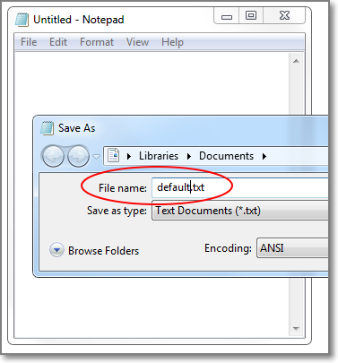
Functional Testing
Task: Test Save feature of Notepad application.
Functional Testing Procedure: test different flows of Save functionality (Save new file, save updated file, test Save As, save to protected folder, save with incorrect name, re-write existed document, cancel saving, etc.)
Defect: While trying to save file using Save As command, still default file name can only be used. User cannot change the filename because the edit-box is disabled.

Slide 20
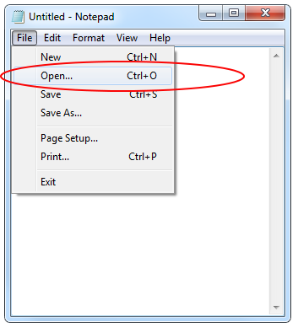
Functional Testing – SMOKE Testing
Task: Test new version of a Notepad application.
Smoke Testing Procedure: quickly check the main Notepad features (run application, type text, open file, edit file, save file).
Defect: There is no ability to Open a file. Button “Open” does nothing.
Summary: build is not accepted, critical bug is logged to a Bug Tracking system, developers team and project manager are informed by QC engineer about that fact.

Slide 21
Non Functional Testing
• Reliability: maturity (robustness), fault-tolerance, recoverability and compliance.
• Usability: understandability, learnability, operability, attractiveness and compliance.
• Efficiency: performance, resource utilization and compliance.
• Maintainability: analyzability, changeability, stability, testability and compliance.
• Portability: adaptability, installability, co-existence, replaceability and compliance.

Slide 22
Verification
Definition: | The process of evaluating work-products (not the actual final product) of a development phase to determine whether they meet the specified requirements for that phase.
Objective: | To ensure that the product is being built according to the requirements and design specifications. In other words, to ensure that work products meet their specified requirements.
Question: | Are we building the product right?
Evaluation Items: | Plans, Requirement Specs, Design Specs, Code, Test Cases
Activities: | Static Testing (Reviews, Walkthroughs, Inspections)

Slide 23
Validation
Definition: | The process of evaluating software or final product during or at the end of the development process to determine whether it satisfies specified business requirements.
Objective: | To ensure that the product actually meets the user’s needs and that the specifications were correct in the first place. In other words, to demonstrate that the product fulfills its intended use when placed in its intended environment
Question: | Are we building the right product?
Evaluation Items: | The actual product/software.
Activities: | Dynamic Testing

Slide 24
Verification Vs Validation
Verification PASSED but Validation FAILED?
It is entirely possible that a product passes when verified but fails when validated.
Example: A product is built as per the specifications but the specifications themselves fail to address the user’s needs.
Trust but Verify.
Verify but also Validate.

Slide 25
Software Development Model
There are various Software Development Models or Methodologies. They are as follows:
Waterfall Model
V-Model
Incremental model
Sequential
Iterative Model
RAD Model
Agile Model
Spiral Model
Prototype Model

Slide 26
Iterative, Sequential, Incremental
Sequential Model?
Incremental Model?
Iterative Model?
Iterative-Incremental Model?

Slide 27
Method, Model, Methodology and Framework
Method (systematic procedure to achieve a result or goal) is subset of bigger umbrella of methodology (systems of methods).
A framework is having multiple methods also provide different solutions but not complete, there is always a room for new addition of solutions.
A framework is a way of representing the empirical relations between every aspect of inquiry.
A model is an abstract form of framework or methodologies.
Relate construction of an house with respect to METHOD, MODEL, METHODOLOGY and FRAMEWORK ?

Slide 28
Software Development Models
Choosing right model for developing of the software product or application is very important.
Based on the model the development and testing processes are carried out.
These days in market the ‘Agile Methodology‘ is the most used model. (WHY?)
‘Waterfall Model‘ is now considered to be the very old model. (WHY?)
‘V-model‘ is also used by many of the companies in their product. ‘V-model’ is nothing but ‘Verification’ and ‘Validation’ model.
Likewise other models are also used based on the requirement of the customer and need of the product.

Slide 29
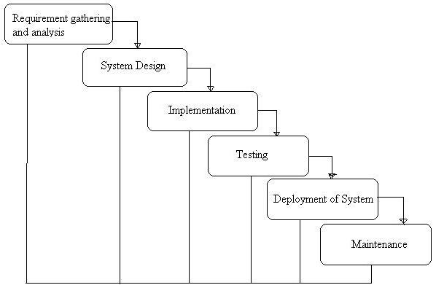
Waterfall Model
The Waterfall Model was first Model to be introduced.
At the end of each phase, a review takes place to determine if the project is on the right path and whether or not to continue or discard the project.
In this model Software Testing starts only after the development is complete.
In waterfall model Phases do not overlap.
Cost of fixing issues are high.

Slide 30
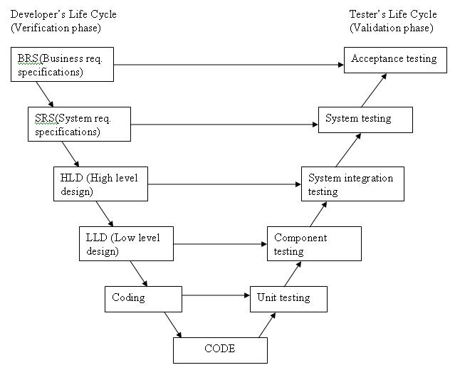
V-Model
A Sequential Model, Testing of the product is planned in parallel with a corresponding phase.
Requirements like BRS and SRS begin the life cycle model just like the waterfall model.
Before development is started, a System Test plan is created.
The Test Plan focuses on meeting the functionality specified in the requirements gathering.

Slide 31
V-Model
The high-level design (HLD) phase focuses on system architecture and design.
It provide overview of solution, platform, system, product and service/process.
An Integration Test plan is created in this phase as well in order to test the pieces of the software systems ability to work together.
The low-level design (LLD) phase is where the actual software components are designed.
It defines the actual logic for each and every component of the system.
Class diagram with all the methods and relation between classes comes under LLD.
Component Tests are created in this phase as well.

Slide 32
V-Model
The implementation phase is, again, where all coding takes place.
Once coding is complete, the path of execution continues up the right side of the V where the test plans developed earlier are now put to use.
Module design is converted into code by developers. Unit Testing is performed by the developers on the code written by them.

Slide 33
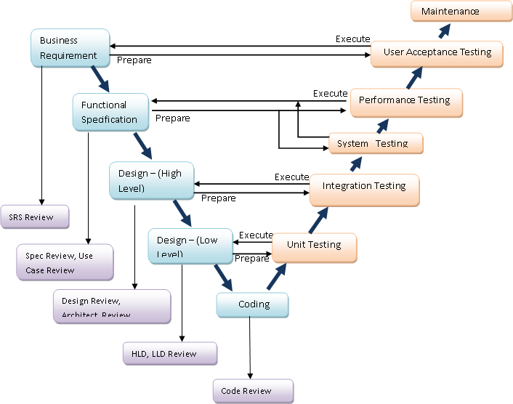
V-Model

Slide 34
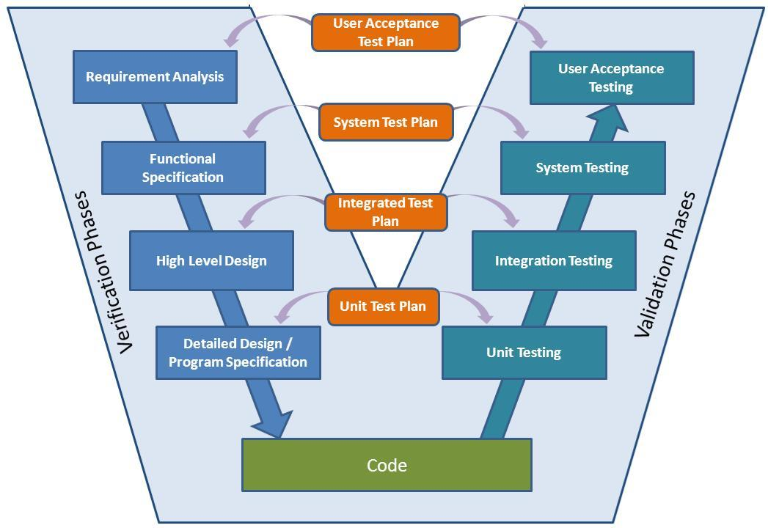
V-Model

Slide 35
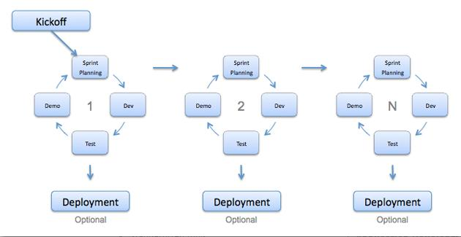
Agile Development Model
Agile development model is an Iterative-Incremental Model.
This results in small incremental releases with iterations.
Each release is thoroughly Tested to ensure Software quality is maintained.
It is used for time critical applications.
SCRUM, KANBAN and Extreme Programming (XP) are currently one of the most well known agile development life cycle model.

Slide 36
Agile Development Model

Slide 37
Agile model
Advantages:
Customer satisfaction by rapid, continuous delivery of useful software.
People and interactions are emphasized rather than process and tools.
Customers, Developers and Testers constantly interact with each other.
Working software is delivered frequently (weeks rather than months).
Face-to-face conversation is the best form of communication.
Close, daily cooperation between business people and developers.
Continuous attention to technical excellence and good design.
Regular adaptation to changing circumstances.
Even late changes in requirements are welcomed.

Slide 38
Agile model
Disadvantages:
Difficult to assess the effort required at the beginning of the software development life cycle especially in large applications.
There is lack of emphasis on necessary designing and documentation.
The project can easily get taken off track if the customer representative is not clear what final outcome that they want.
Only senior programmers are capable of taking the kind of decisions required during the development process. Hence it has no place for newbie programmers, unless combined with experienced resources.

Slide 39
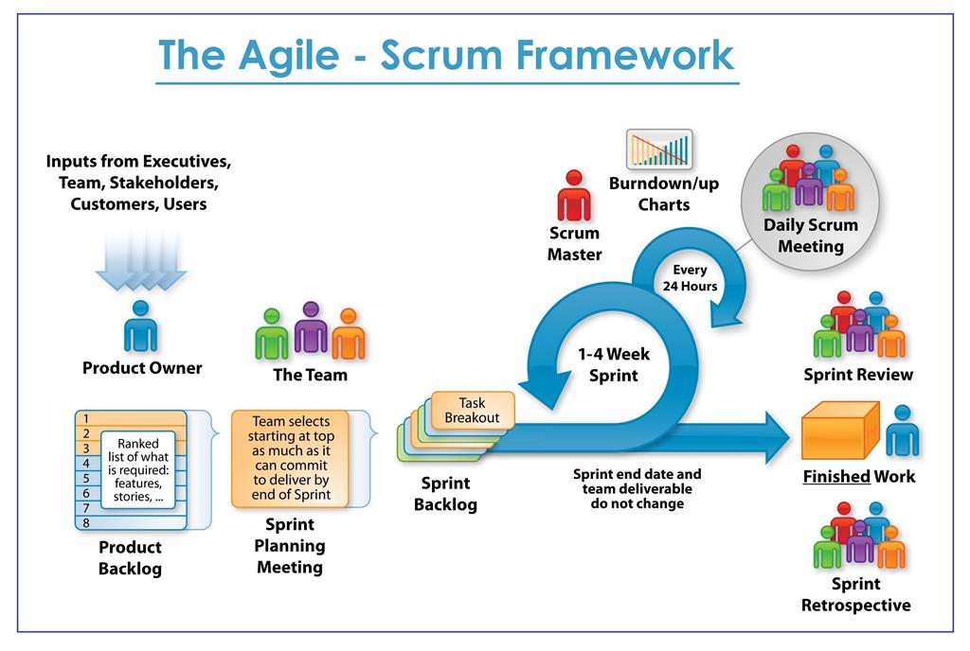
Agile Model

Slide 40
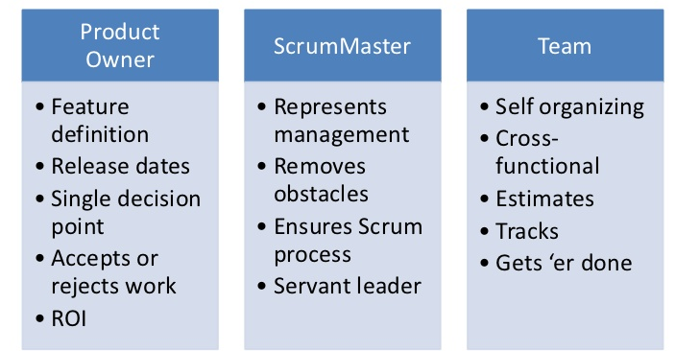
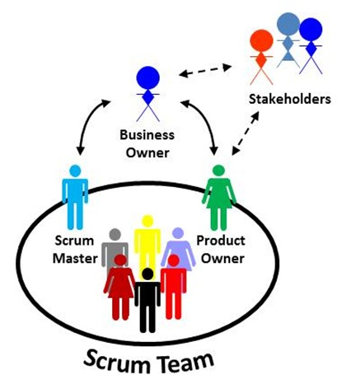
Agile SCRUM Team and Roles

Slide 41
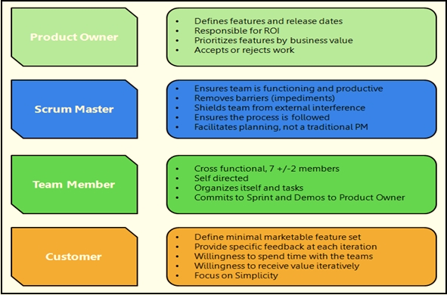
Agile SCRUM Team and Roles

Slide 42
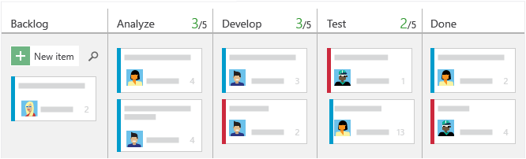
Agile KANBAN

Slide 43
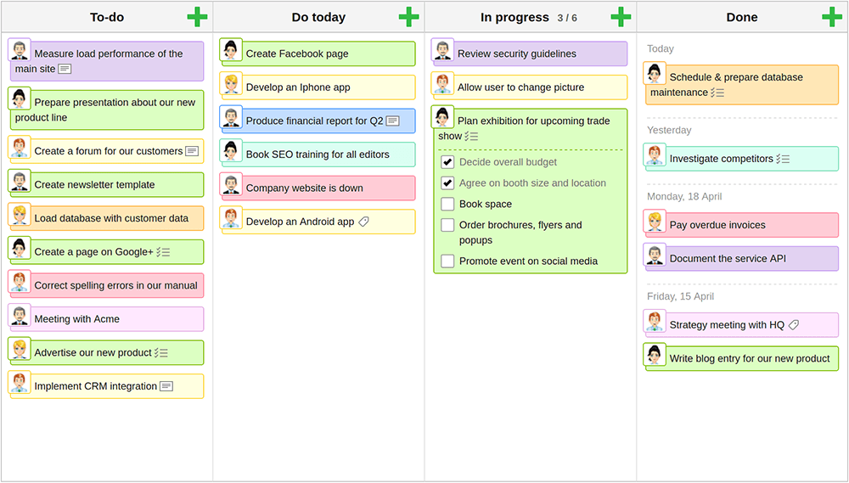
Agile KANBAN

Slide 44
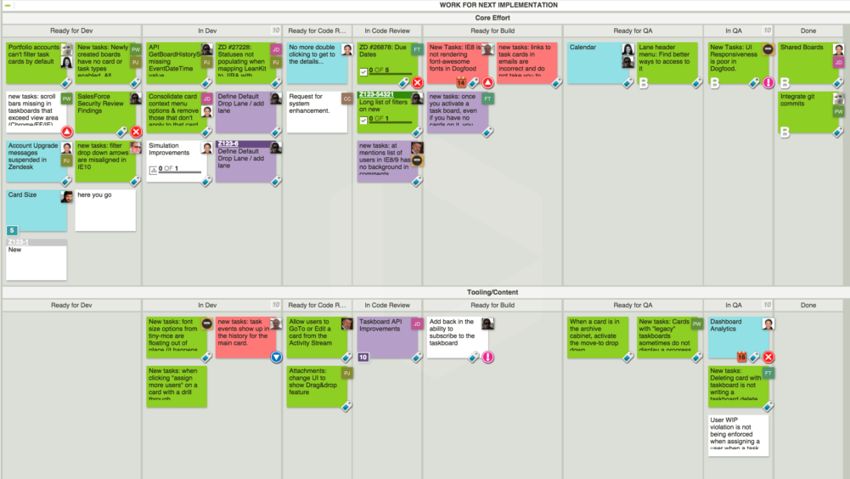

Slide 45
Defect Management

Slide 46
Defect Management Process
A Defect in Software Testing is a variation or deviation of the software application from the end user’s requirements or original business requirements.
A software defect is an error in coding that causes incorrect or unexpected results from a software program that does not meet actual requirements.

Slide 47
Bug Report Contains
Defect ID
Unique identification number for the defect.
Defect Description
Detailed description of the Defect including information about the module in which Defect was found.
Version
Version of the application in which defect was found.
Steps
Detailed steps along with screenshots with which the developer can reproduce the defects.
Date Raised
Date when the defect is raised
Reference
where in you Provide reference to the documents like . requirements, design, architecture or maybe even screenshots of the error to help understand the defect
Detected By
Name/ID of the tester who raised the defect

Slide 48
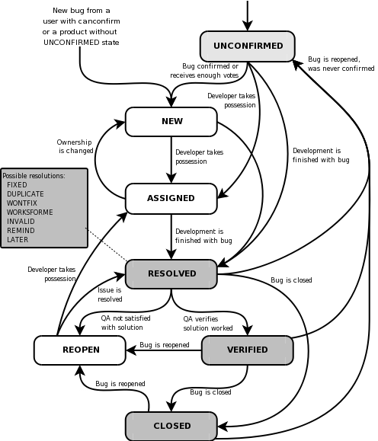
Good bug reports contains:
Descriptive Title
Concise Description
Expected Results
Details About The Project And Version
Platform Details
Defect Type And Severity
Steps To Reproduce Visual Attachment
Tags & Links
Assignee

Slide 49
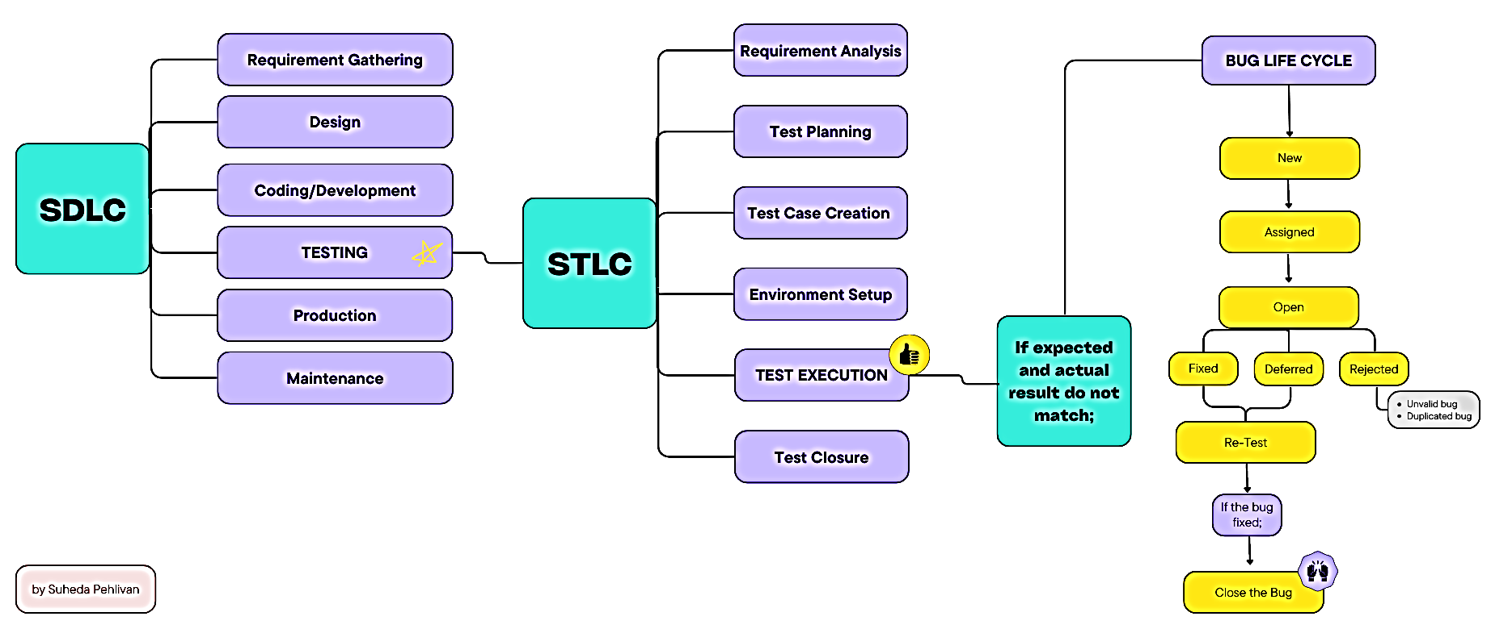

Slide 50
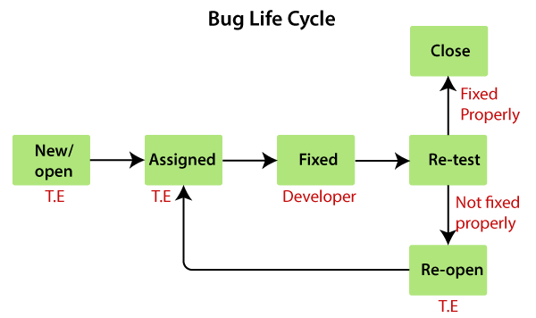
Bug Life Cycle

Slide 51
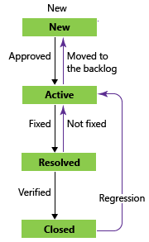
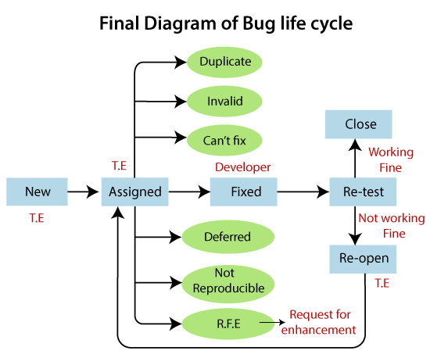
Bug Life Cycle

Slide 52
How to measure and evaluate the
quality of the test execution?
Defect Rejection Ratio
(No. of defects rejected / Total no. of defects raised)*100
Defect Leakage Ratio
(No. of defects missed / Total defects of software)*100

Slide 53
Defect Management Process
Example:
Supposed the Bank website has total 64 defects, but your testing team only detect 44 defects i.e., they missed 20 defects. Therefore, you can calculate:
- The defect leakage ratio (DLR) is 20/64 = 0.312 (31.2 %).
Example:
Out of 84 defects, we reported over the 64 are defects which means our 20 defects we reports are all wrong, it is a mistake during testing period so how we can calculate defect rejection ratio?
- The defect rejection ratio (DRR) is 20/84 = 0.238 (23.8 %).

Slide 54
Defect Management in
JIRA

Slide 55
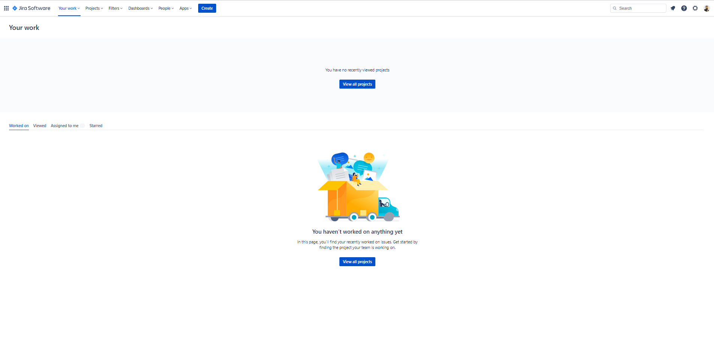

Slide 56
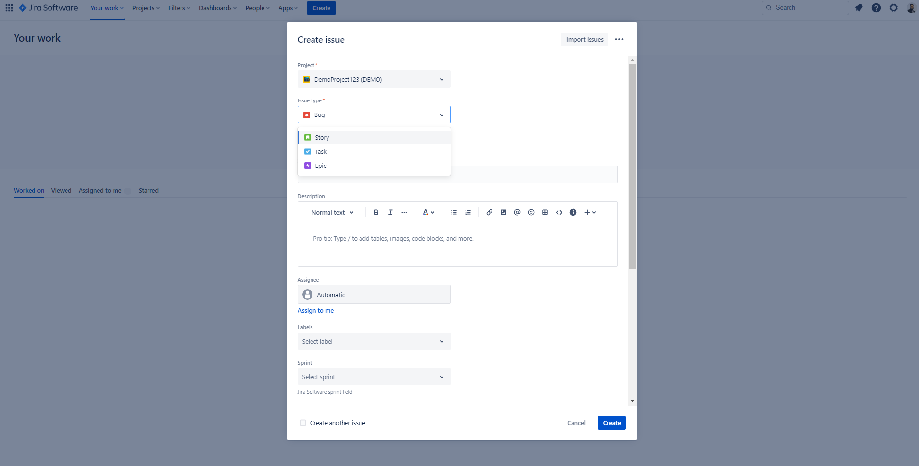
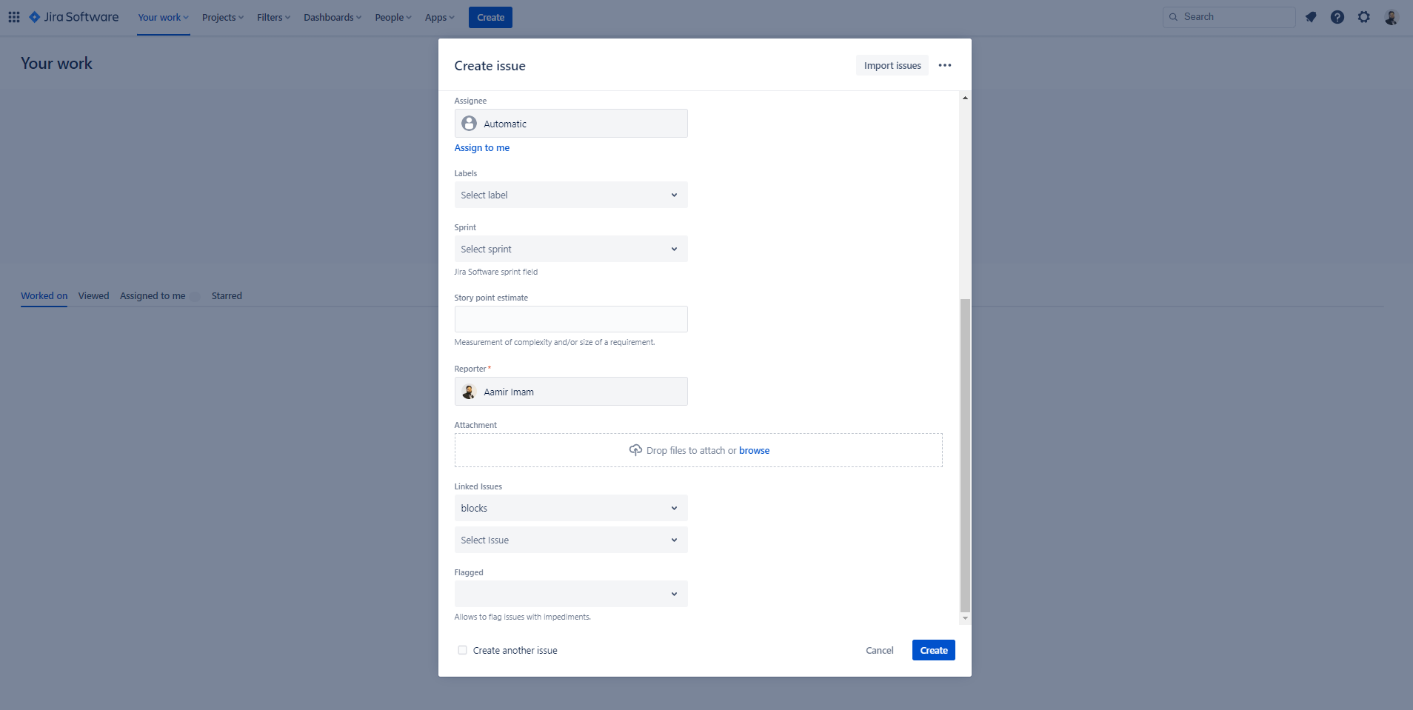
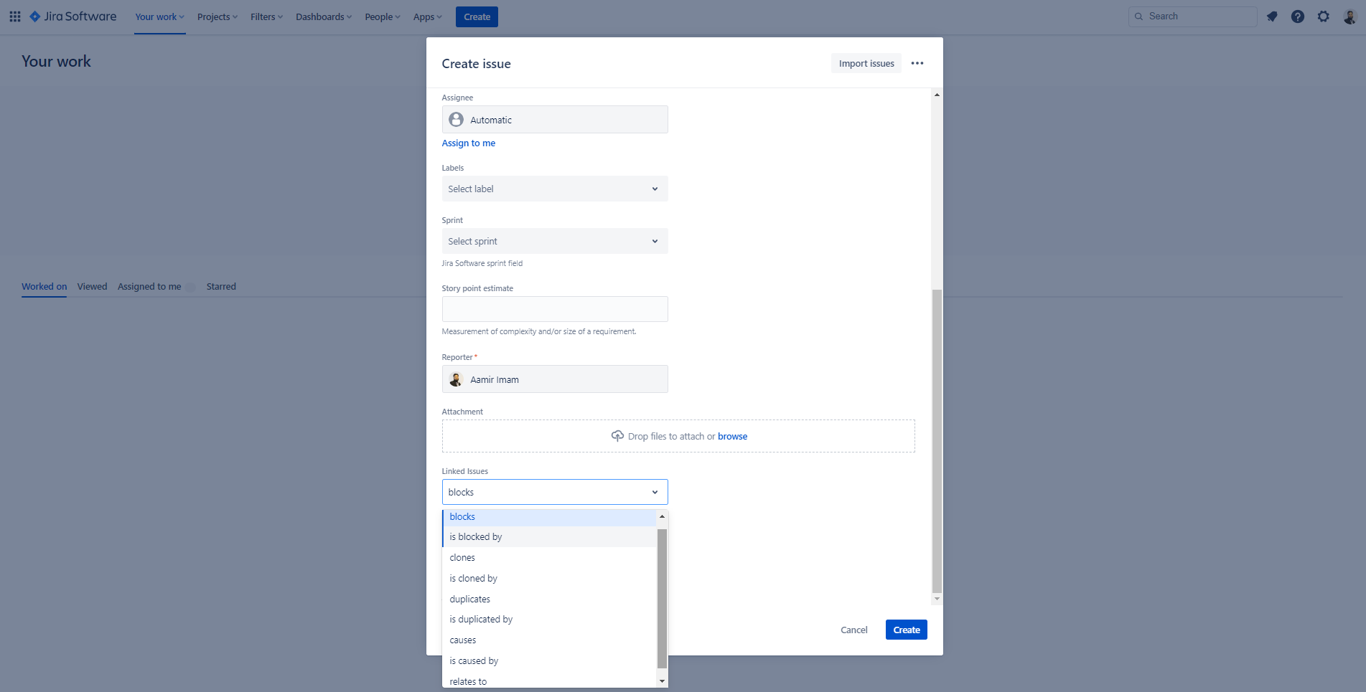

Slide 57
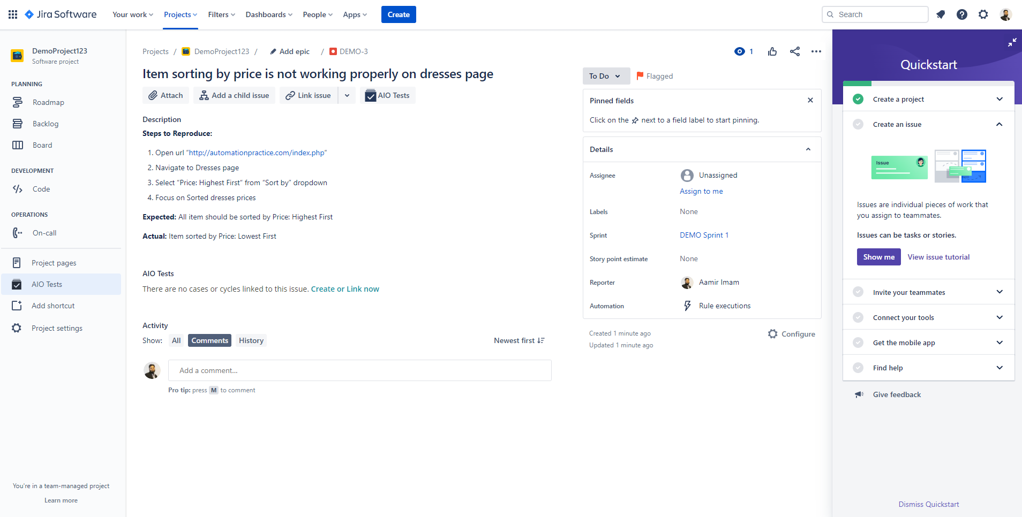
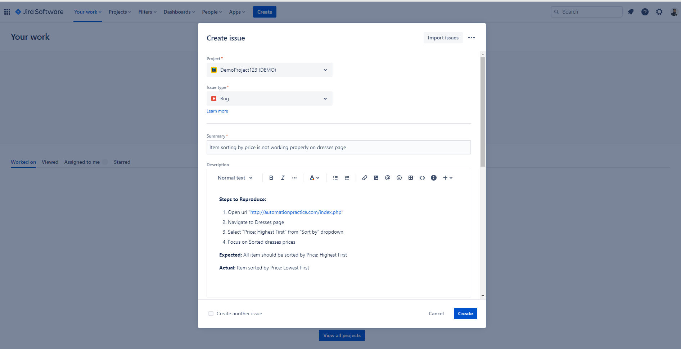
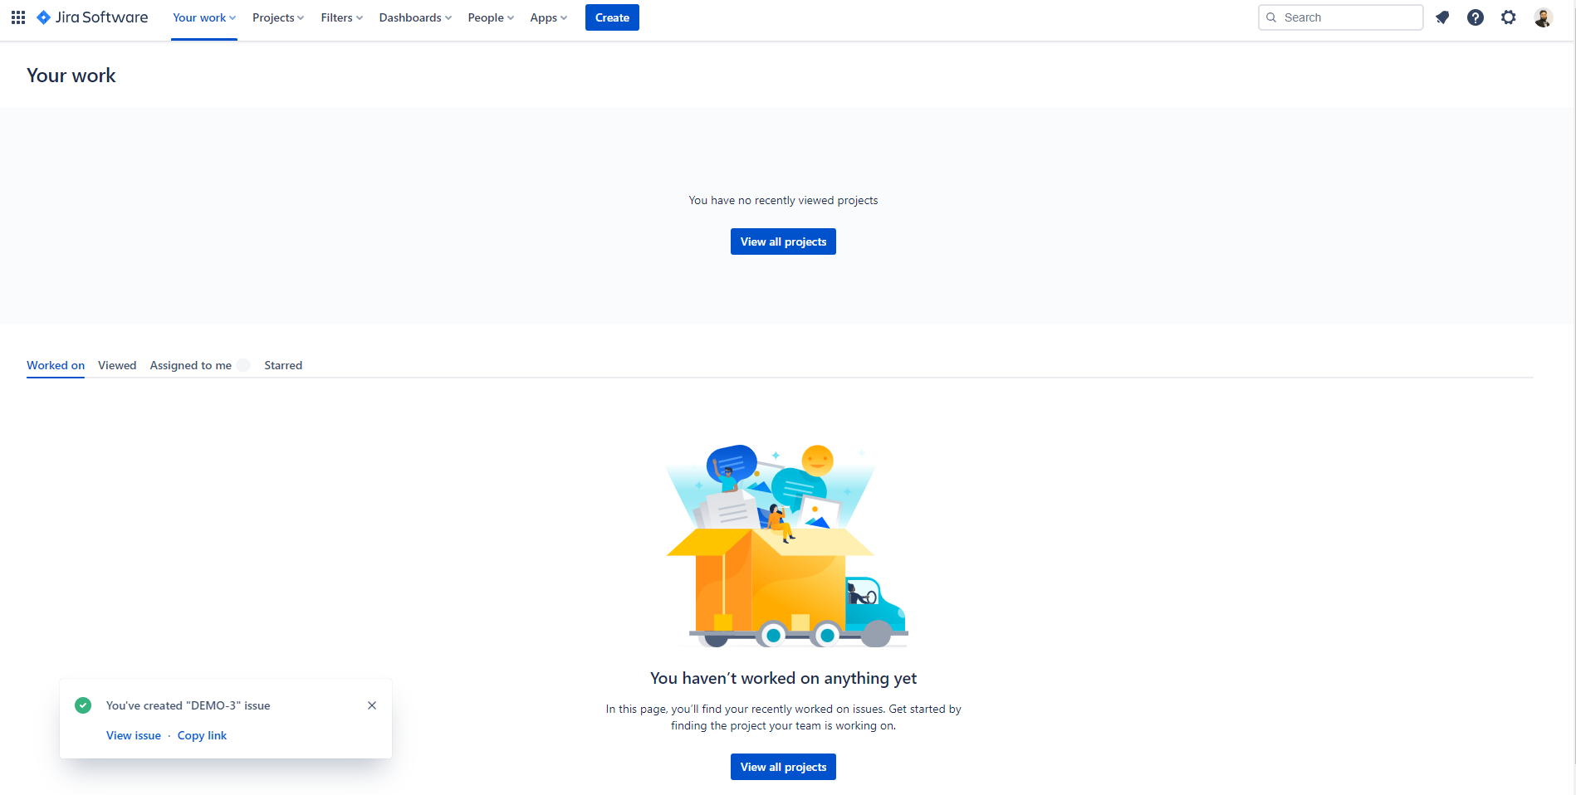

Slide 58
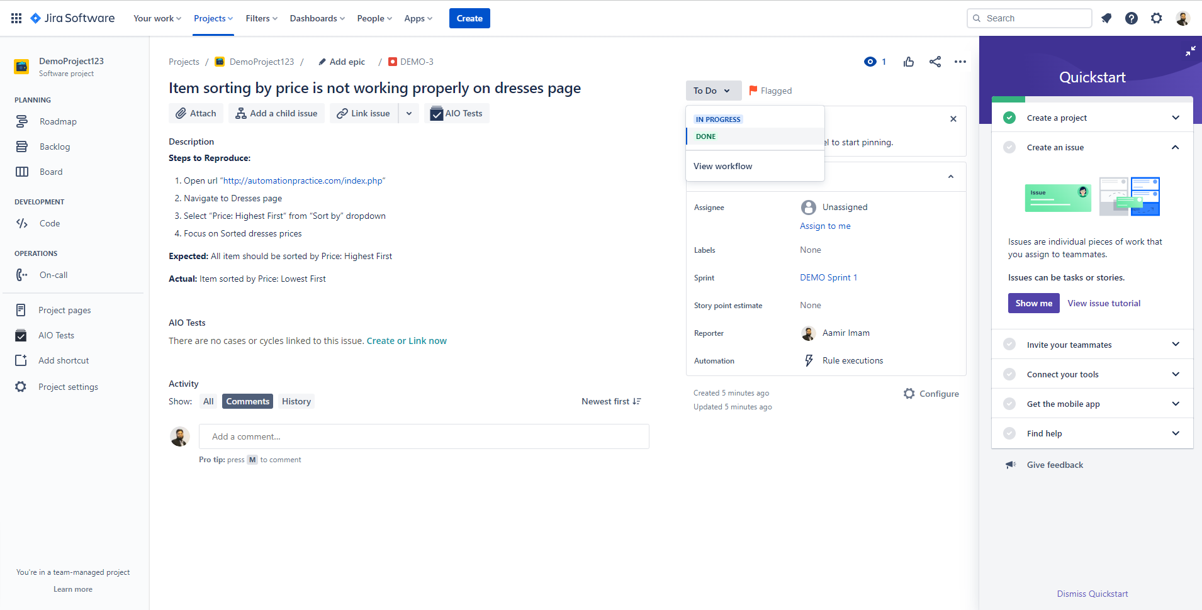
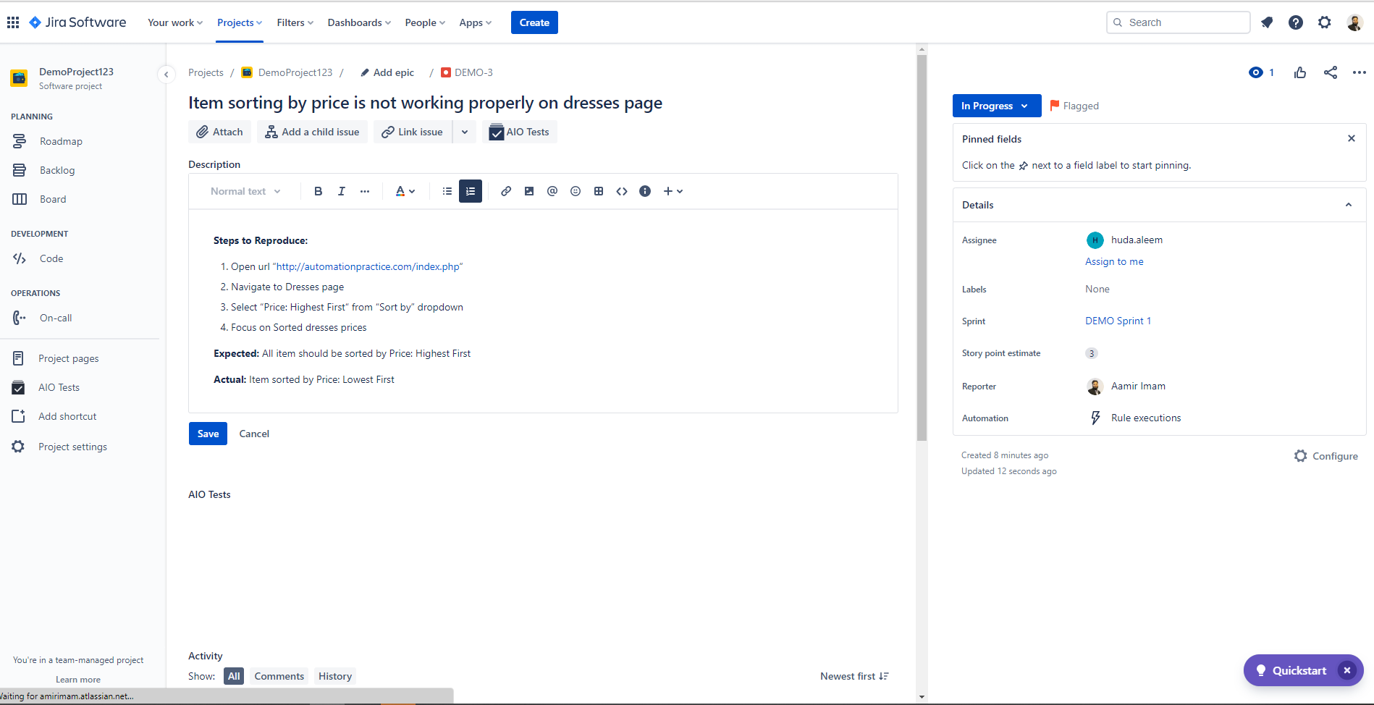
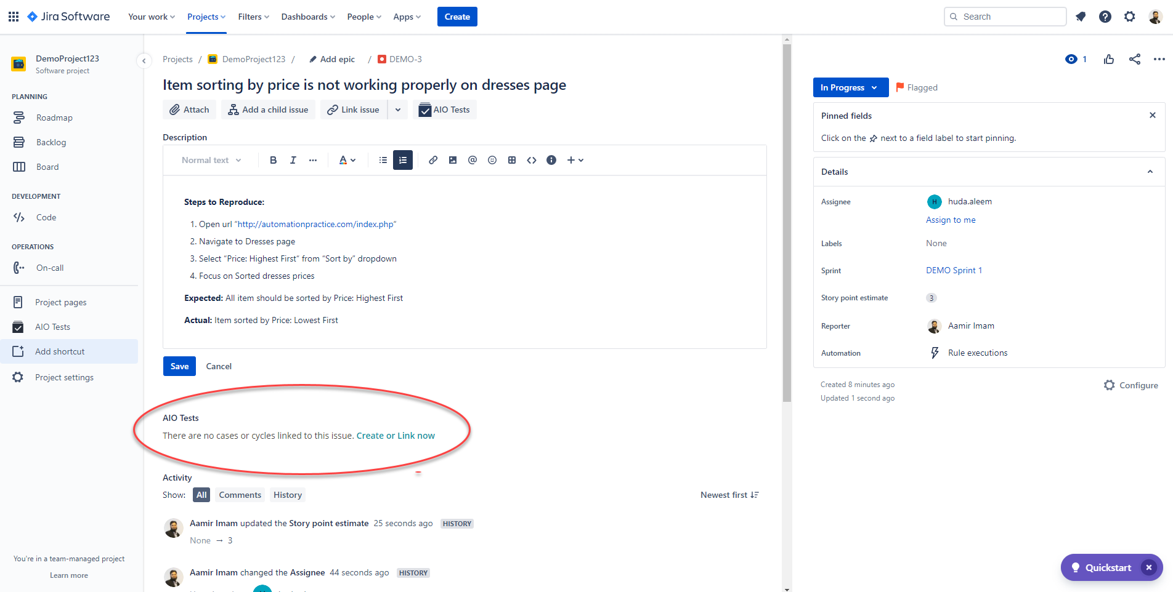
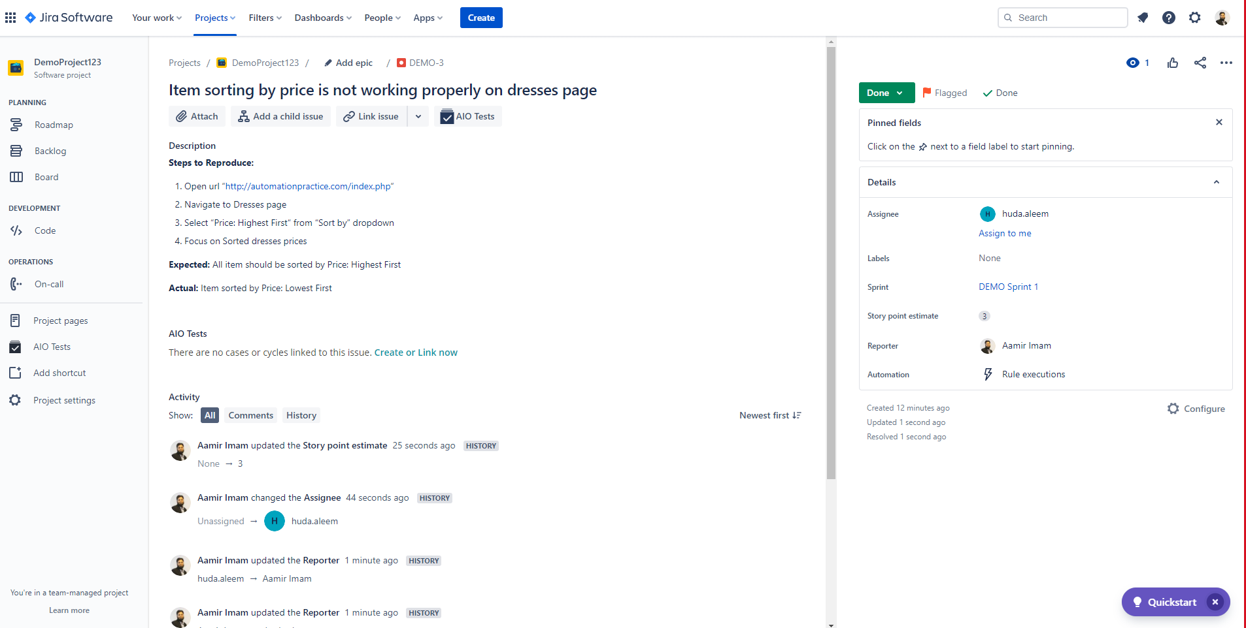

Slide 59
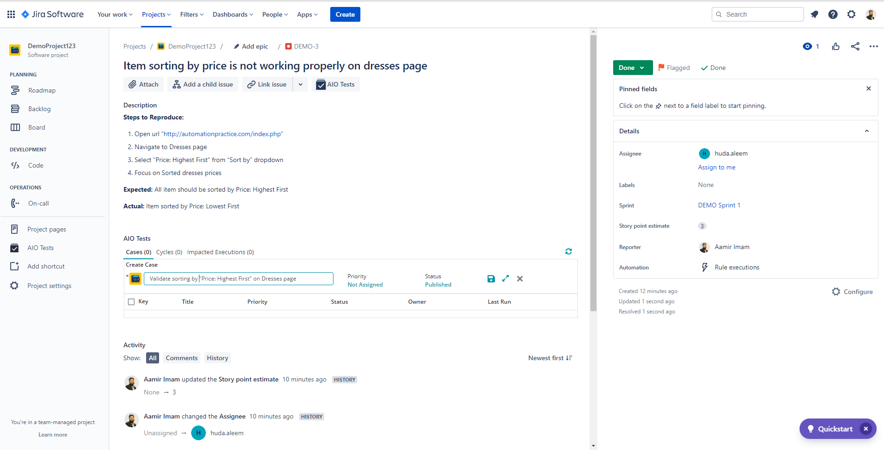
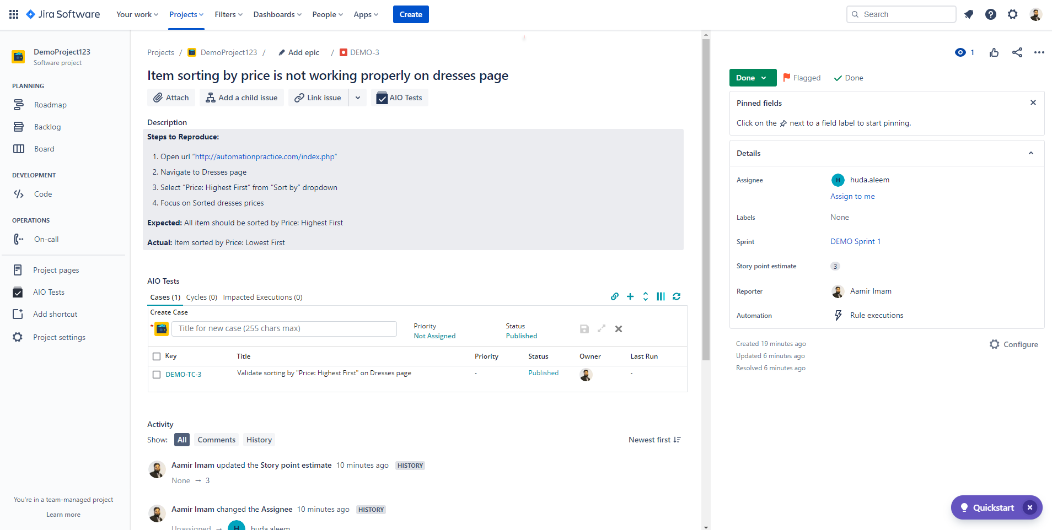
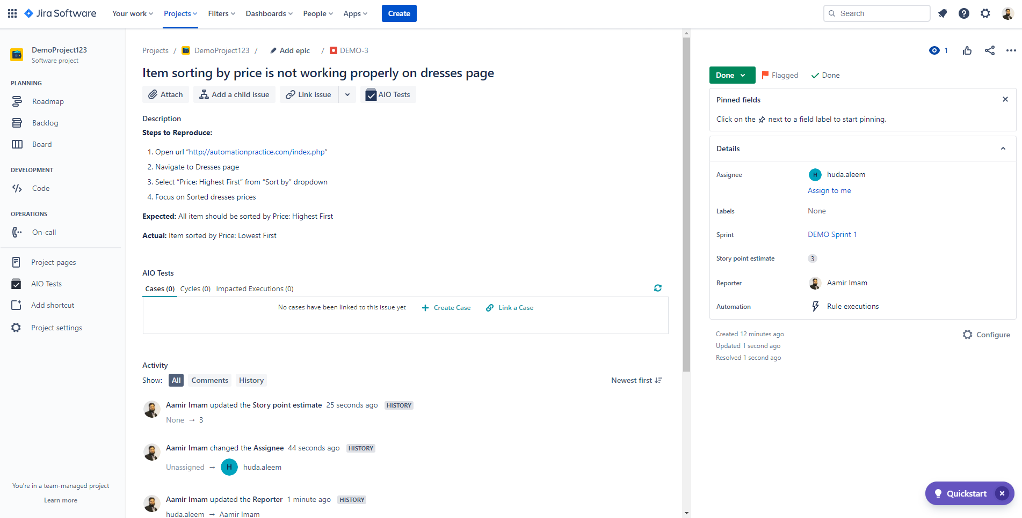


Slide 60
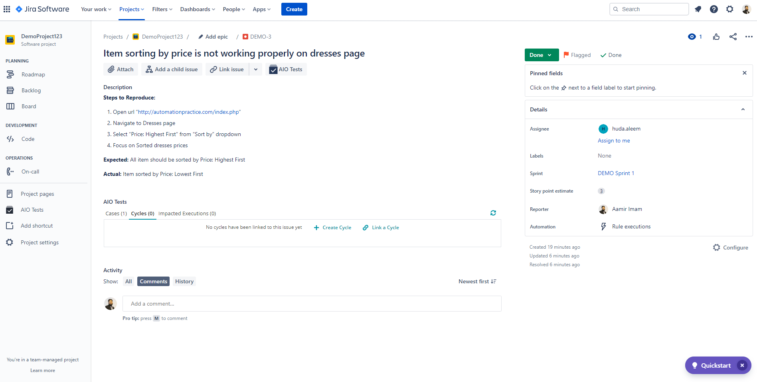
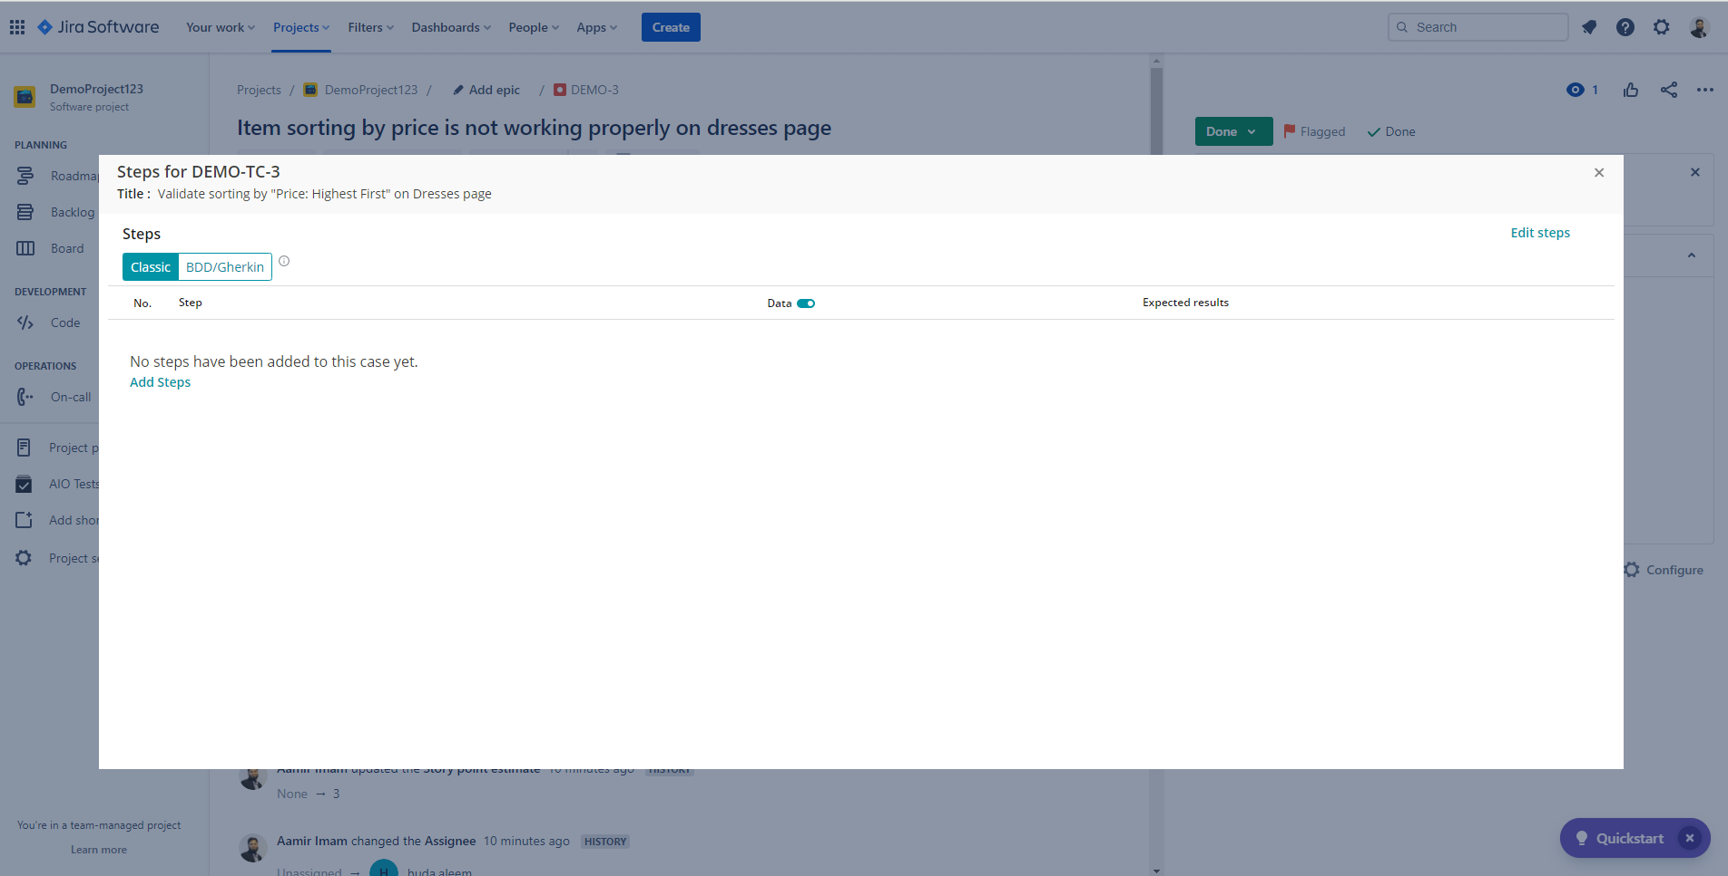
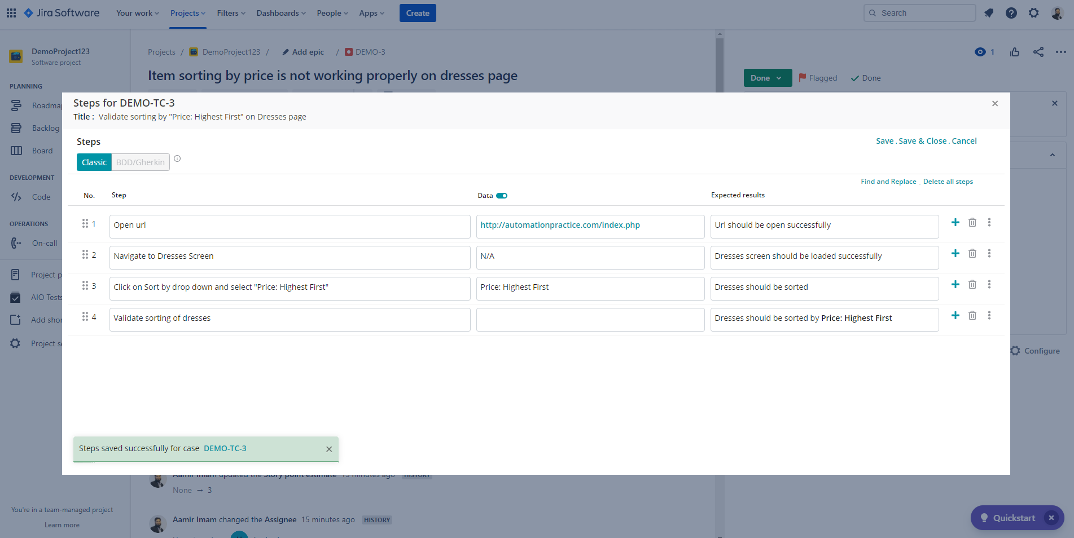
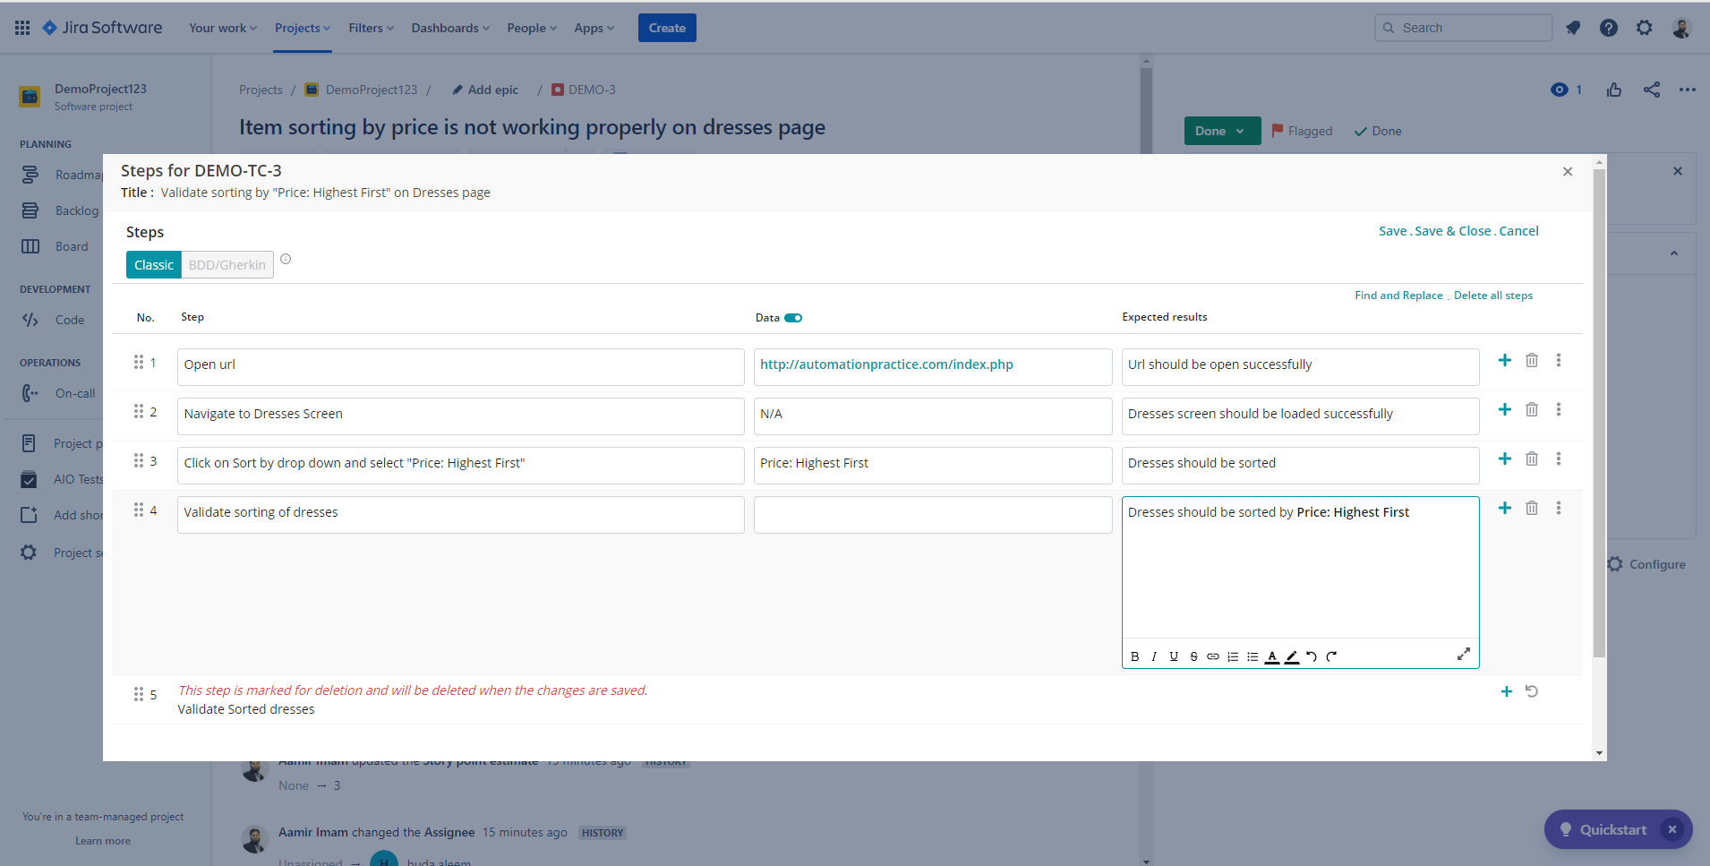

Slide 61
Defect Management in
Azure DevOps

Slide 62
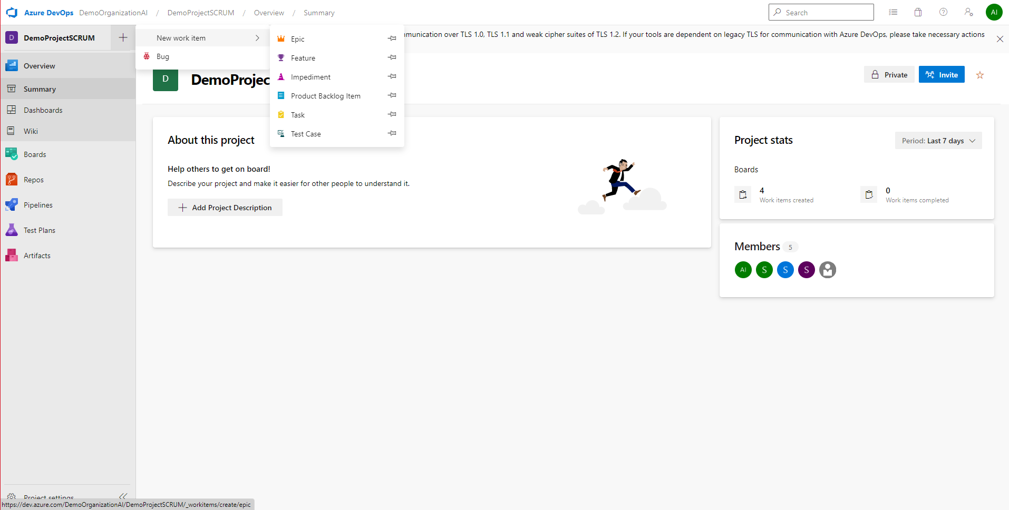

Slide 63
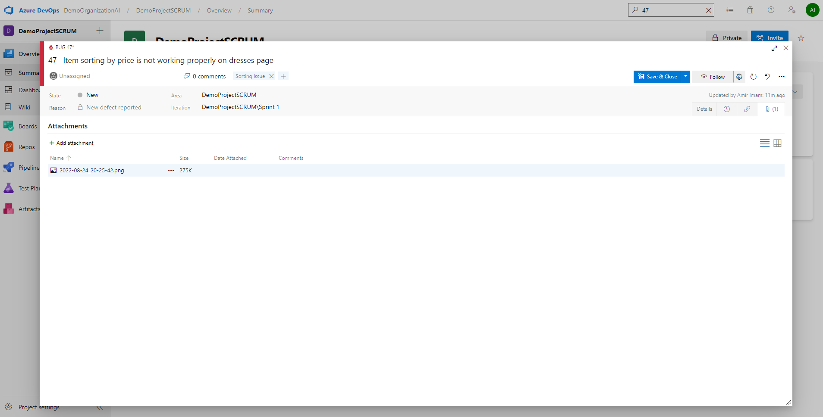
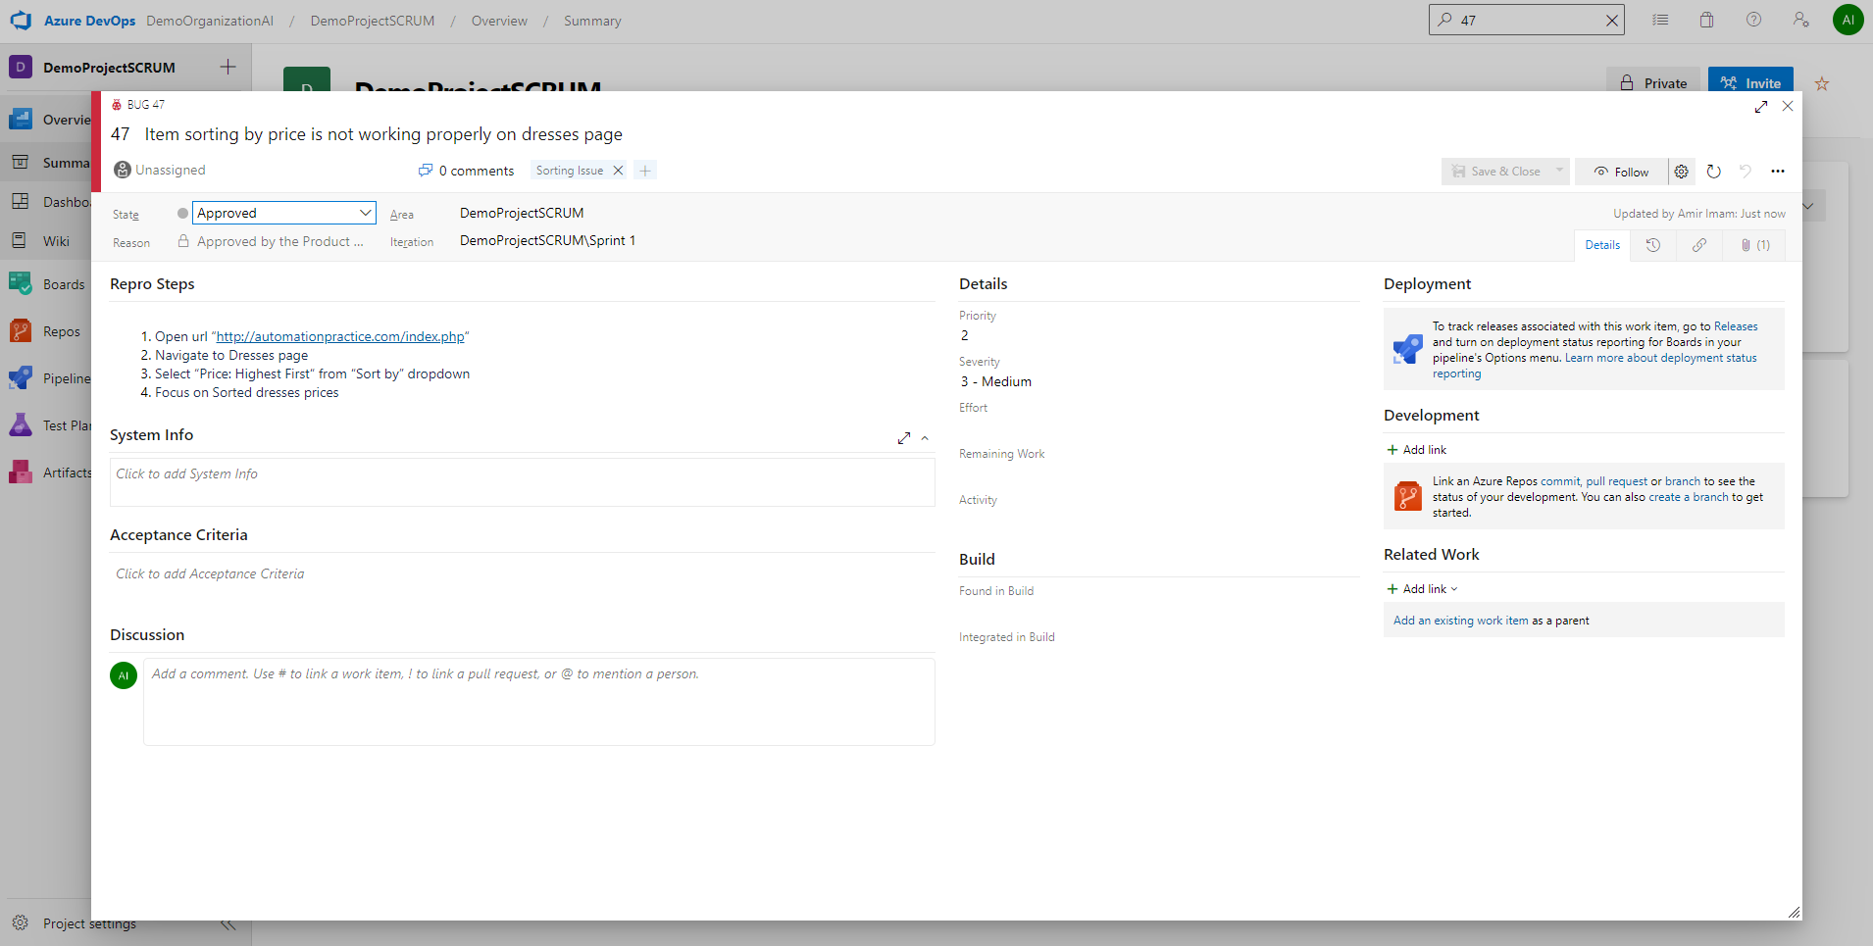
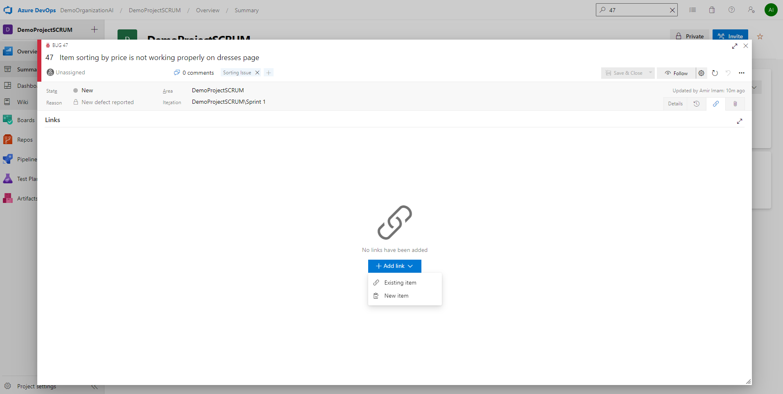
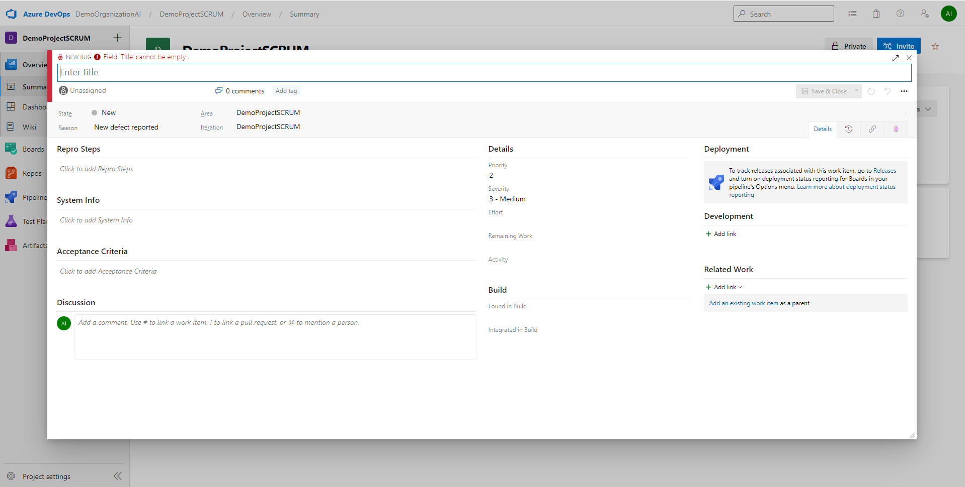
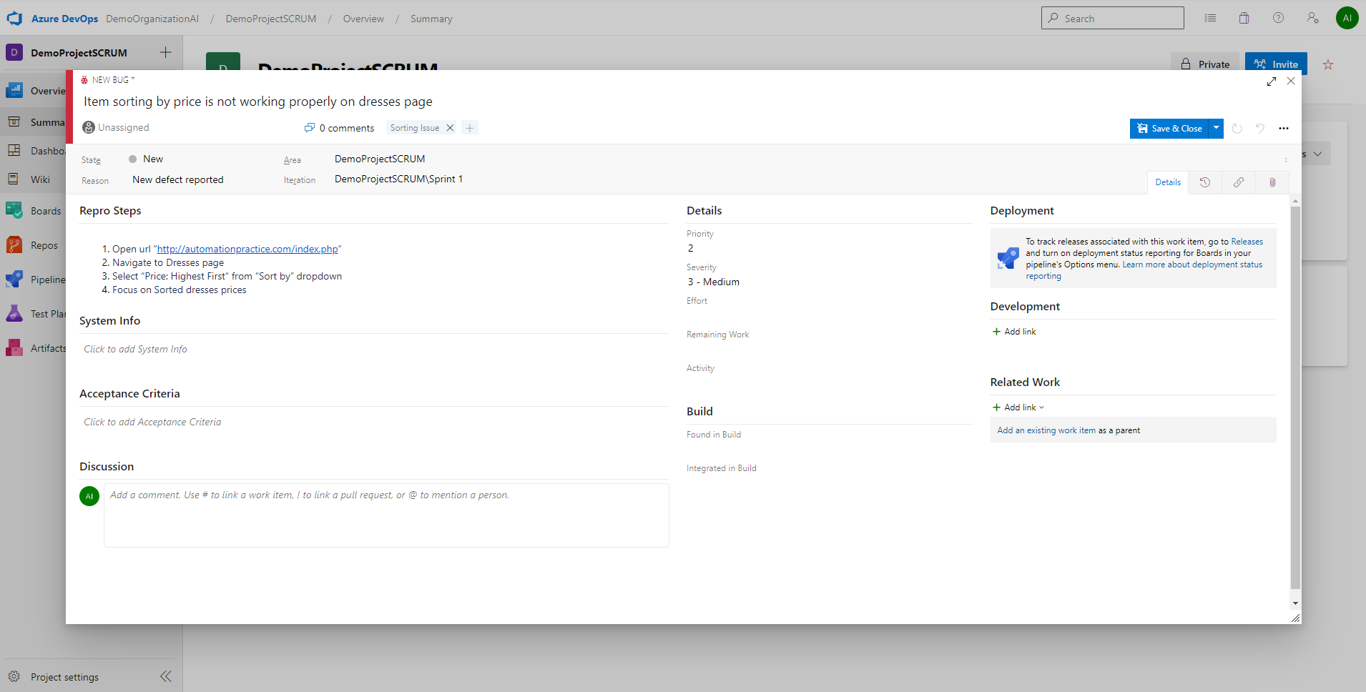
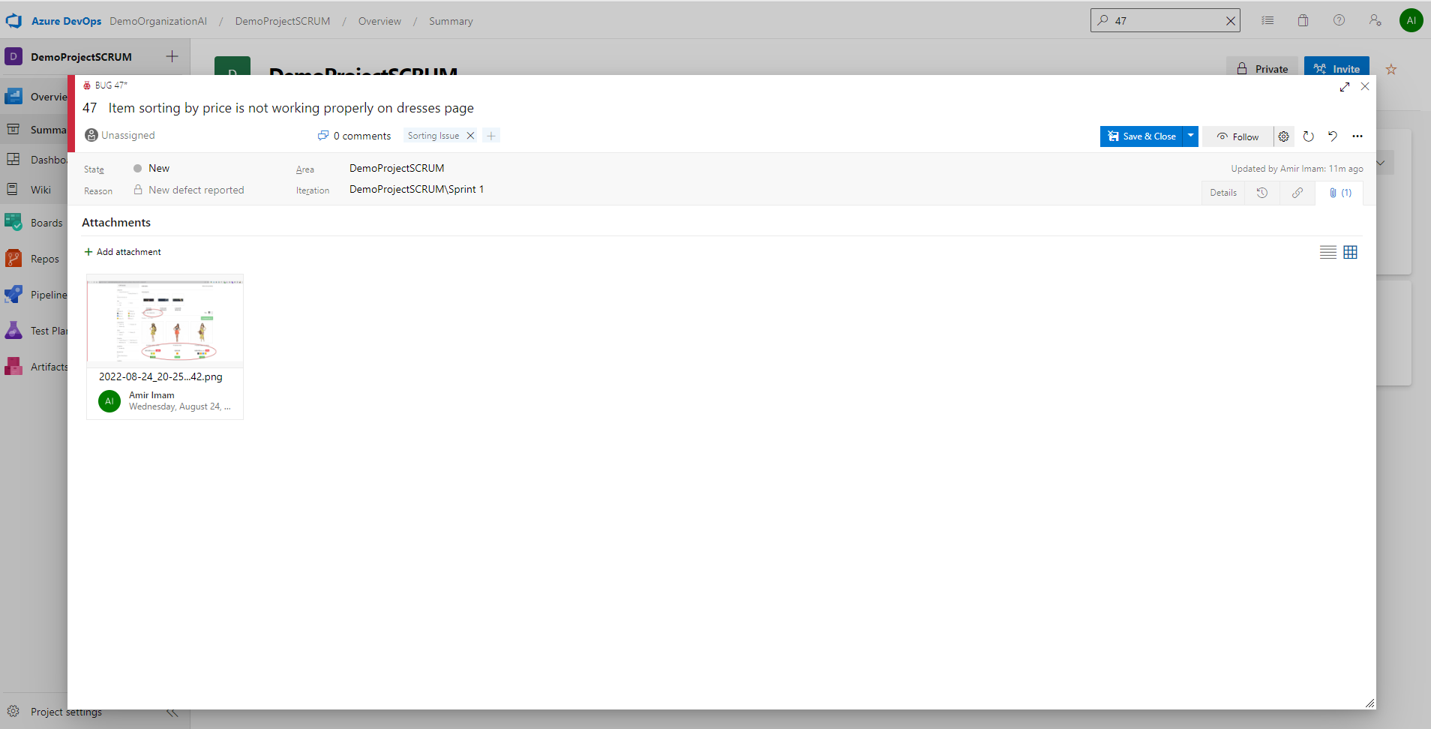
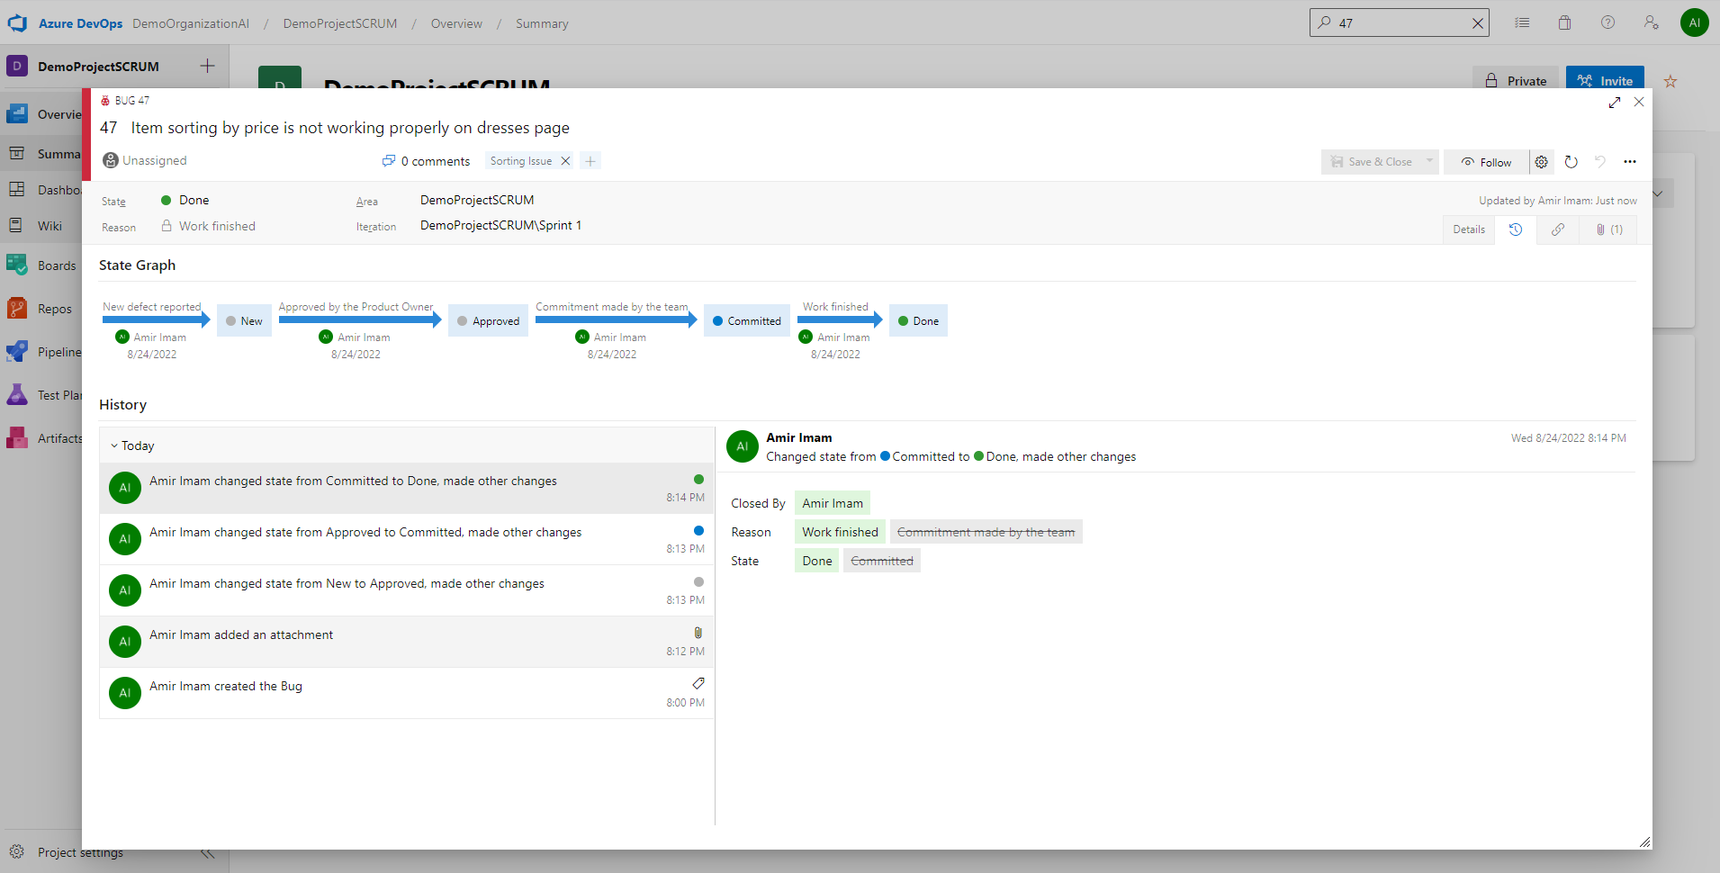






Slide 64




Slide 65
Any Question?
End!

